Slide 1


EcoSync: Revolutionizing Urban Gardening with AI-powered Smart Planters
Product Name: EcoSync
Tagline: "Grow Smart, Effortlessly."
Company Name: LeafMind
Bipasha Acharjee
Founder

Slide 2
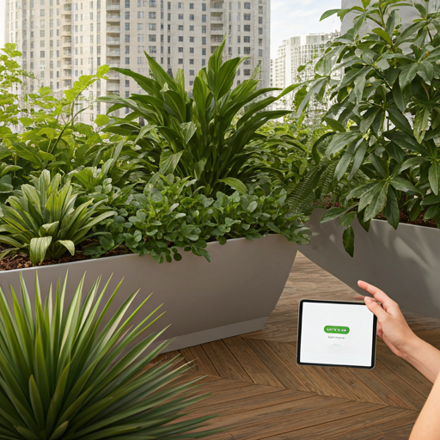

Introduction
Welcome to the future of urban gardening!
Today, we introduce EcoSync, an innovative AI-powered smart planter designed to transform the way we care for plants in urban environments.
EcoSync is a cutting-edge product developed by LeafMind, aimed at simplifying plant care and promoting sustainability.
Combining artificial intelligence with IoT technology, EcoSync provides personalized, automated care for plants, ensuring optimal growth conditions for every type of plant.
Our mission is to redefine urban gardening by creating a seamless, intelligent solution that empowers city dwellers to grow plants effortlessly and sustainably, no matter their gardening experience.

Slide 3

The Challenges of Urban Gardening: Why EcoSync is Needed
Urban gardeners face challenges like inconsistent plant care, lack of knowledge, and time constraints.
Over 80% of urban dwellers struggle with maintaining healthy plants due to busy lifestyles.
Environmental impact of inefficient plant care (e.g., water wastage, poor growth).
As more people in cities take up gardening for both relaxation and sustainability, there's an increasing demand for tech-driven solutions that make plant care effortless, efficient, and personalized.

Slide 4
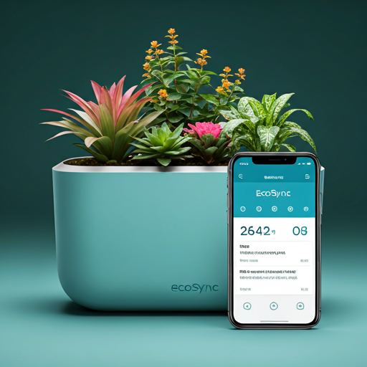
Introducing EcoSync:
The AI-Powered Smart Planter
EcoSync: An AI-powered smart planter.
Monitors growth, health, and environmental conditions.
Provides actionable insights and automatic adjustments for optimal plant care.
Simplifies gardening for urban dwellers.
EcoSync redefines urban gardening by making plant care effortless, sustainable, and tailored to individual needs, allowing city dwellers to enjoy the beauty of thriving plants with minimal effort.

Slide 5
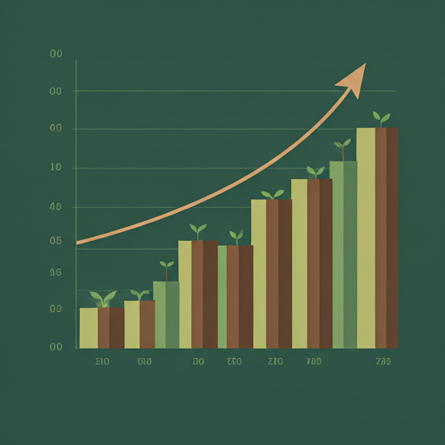
The Growing Urban Gardening Market and EcoSync’s Potential
Increasing Interest in Sustainable Living:
Urban dwellers are increasingly seeking eco-friendly solutions, creating demand for smart gardening products like EcoSync.
Target Market Segments:
Urban Dwellers:
Busy city residents seeking effortless plant care.
Tech-Savvy Gardeners:
Millennials and Gen Z adopting IoT-enabled, smart home devices.
Sustainability Enthusiasts:
Individuals passionate about eco-conscious living and resource efficiency.
With the increasing demand for sustainable, easy-to-use, and tech-driven gardening solutions, EcoSync is positioned to capture the attention of urban gardeners and tech-savvy consumers alike.

Slide 6
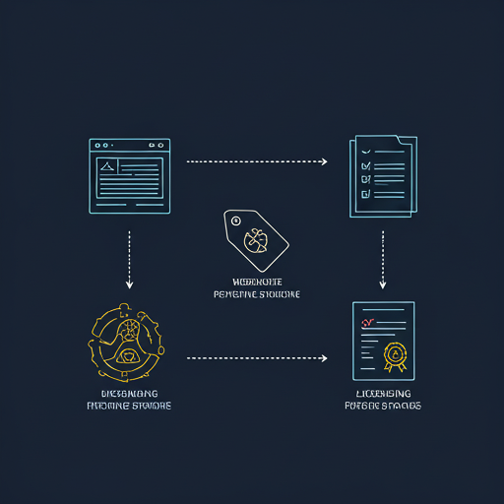
Business Model
Revenue Streams:
Direct-to-Consumer Sales:
EcoSync will be sold through our website and e-commerce platforms.
Retail Partnerships:
Partnering with garden centers, tech retailers, and sustainable living stores.
Licensing Technology:
Licensing EcoSync’s AI technology to other gardening product manufacturers or smart home companies.
Pricing Strategy:
Premium Yet Competitive:
Offering high-quality, tech-driven products at a price point that reflects the value while remaining accessible to our target market.

Slide 7
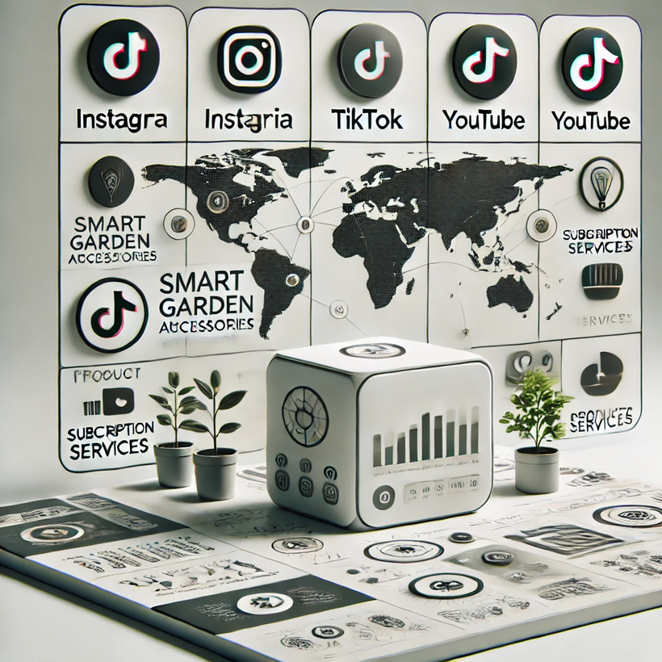
Marketing & Growth Strategy
Branding & Positioning:
Luxury & Practicality: Premium, eco-friendly solution combining AI technology for urban gardeners.
Digital Marketing:
Social Media & Influencers: Engaging content and partnerships on Instagram, TikTok, and YouTube.
Targeted Ads: Ads on social media and search engines to reach tech-savvy, eco-conscious customers.
Expansion Plans:
International Markets: Expanding to global cities with a demand for smart, sustainable gardening.
Diverse Product Lines: Developing smart accessories and subscription services for plant care analytics.

Slide 8
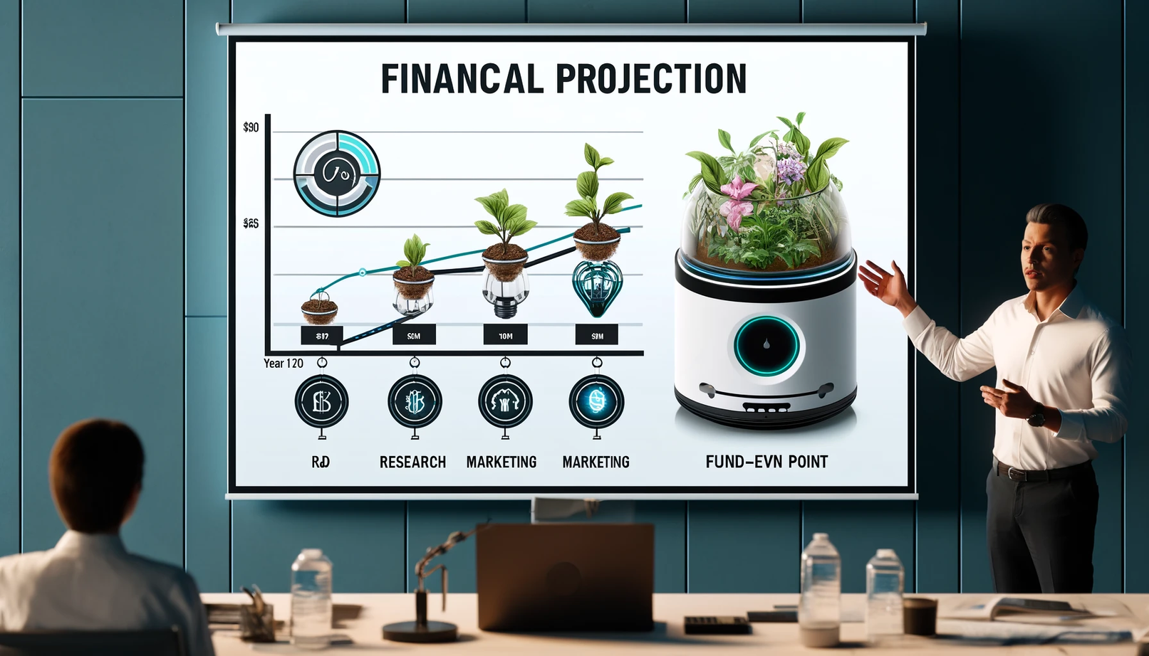
Financial Projections for EcoSync
Revenue Forecast (3-5 Years)
Year 1: $250,000
Year 2: $600,000
Year 3: $1.2M
Year 4: $2.5M
Year 5: $5M
Break-even Analysis
Break-even Point: Expected in Year 2
Cumulative Revenue by Year 2: $850,000
Units Required to Break Even: 10,000 units at $100 each
Funding Allocation (Year 1 - Year 3)
R&D: 40% ($400,000)
Focus on refining AI algorithms, expanding plant compatibility, and hardware improvements
Marketing & Sales: 35% ($350,000)
Digital marketing campaigns, influencer collaborations, trade shows, and product distribution
Scaling Operations: 25% ($250,000)
Expansion into new markets, manufacturing setup, and supply chain optimization

Slide 9


The Team
Founder: Bipasha Acharjee
Expertise: Product Development, AI Technology, and Visionary Leadership
Raj Barma – Chief Technology Officer (CTO)
Expertise: AI & Machine Learning, Embedded Systems, IoT Solutions
Asha Chatterjee – Chief Marketing Officer (CMO)
Expertise: Brand Strategy, Market Expansion, Digital Marketing
Emma watson– Chief Operating Officer (COO)
Expertise: Operations, Supply Chain Management, Scaling Startups
Advisors
Dr. Sarah Thompson – Industry Expert in Sustainability and Urban Agriculture
Mr. John Miller – Former Senior Executive at GreenTech Innovations
Partners
TechSolutions Inc. – Technology Provider for IoT Integration
UrbanGrow Co. – Retail Partner for Distribution Channels

Slide 10
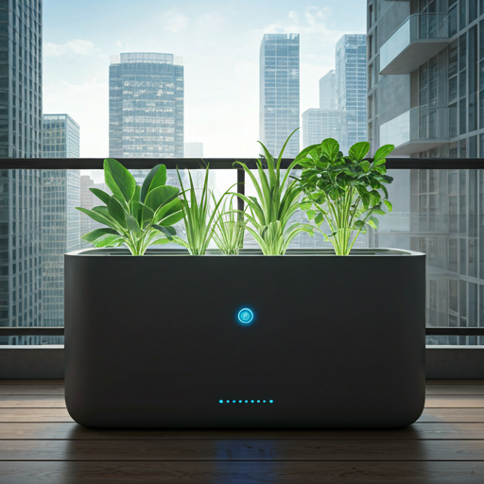
Why Invest in EcoSync?
Strong Market Opportunity: Growing demand for smart home gardening solutions in urban areas.
Unique Product: AI-powered smart planter that adapts to plant needs, ensuring optimal growth and health.
Scalable Business Model: Easy expansion potential with a focus on urban gardeners, offering high ROI through innovative technology.

Slide 11
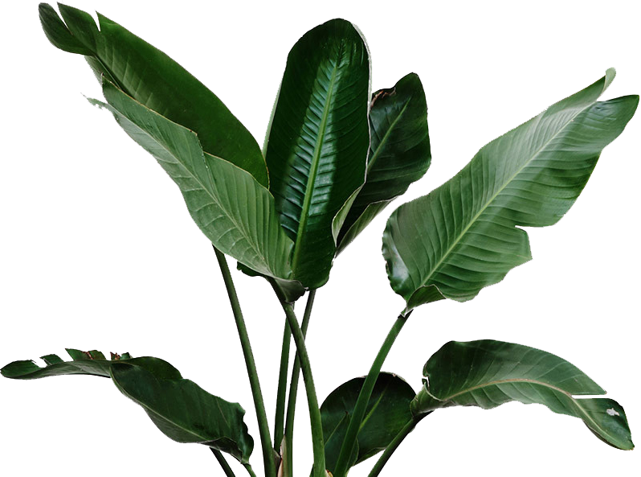
Connecting for the Future of Urban Gardening
Thank You.
Please feel free to ask any questions you may have about EcoSync or the investment opportunity
Contact Us
+91 7234567890
leafmind.com
hello@leafmind.com

